Slide 1
IEP TOOL KIT: A PARENT SUPPORT
Notes:
NOTE:
To change the image on this slide, select the picture and delete it. Then click the Pictures icon in the placeholder to insert your own image.

Slide 2
COMMUNITY ADVISORY COMMITTEE (CAC)
Welcome!
Vicky Iqueda vickyiqueda@gmail.com
Anna Maria Cruz acruz@hemetusd.org
Christa Smith christa@rcselpa.org

Slide 3
IEP TOOL KIT: A PARENT SUPPORT
ICE-BREAKER
BUILDING RELATIONSHIP
TEACHERS
PARENT
STUDENT
Notes:
NOTE:
To change the image on this slide, select the picture and delete it. Then click the Pictures icon in the placeholder to insert your own image.

Slide 4
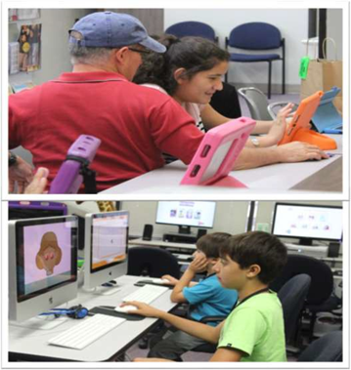
CAC
CAC does not advise parents as to the nature of a child’s disability or needs, nor do we recommend placements or therapies.
Family Support:
Educational workshops
Referrals and resources
Community outreach
CAC LINK

Slide 5
The Individualized Education Program
(IEP) Team Process
What is an IEP
The IEP is a written plan for the child who qualifies for special education services.
What is an IEP Team Approach?
The IEP team approach is the collaborative effort between You, your child’s teacher(s), and significant others
Who is on the IEP Team?
You, the parent/guardian
An administrator or designee who is knowledgeable about general curriculum and about availability of LEA resources
Your child’s special education teacher(s)
At least one general education teacher if your child is or might be participating in a general education environment
Your child (if appropriate)
Eng - Guide for parents
Spn - Guia para padres

Slide 6
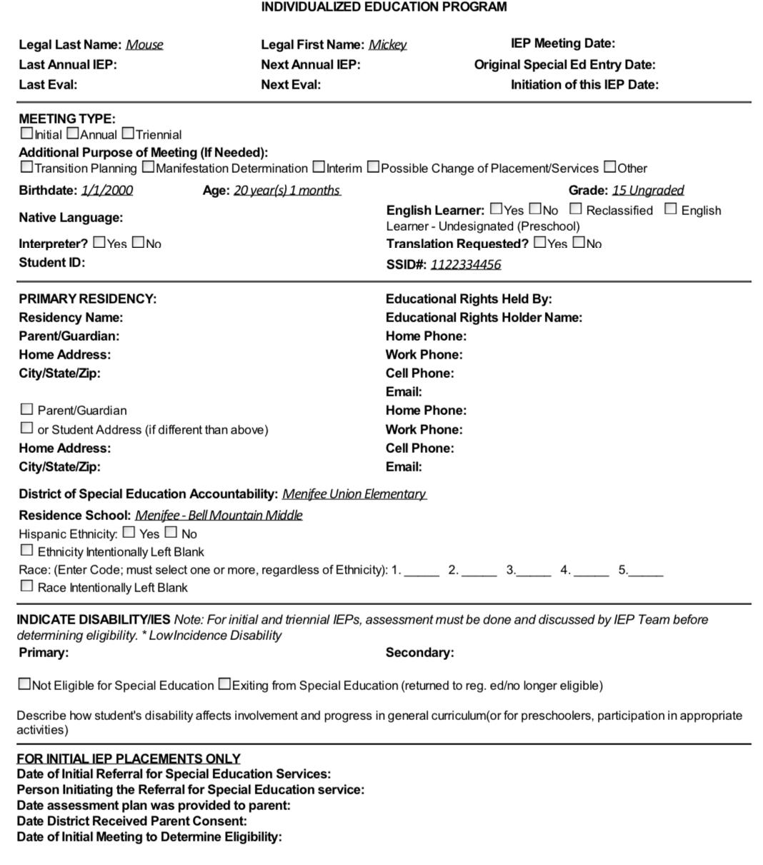
What must the IEP contain?
Student eligibility / Information
Annual goals - short term and long term
Parent consent and the signature
Signature of IEP team members attended
Present levels of educational performance.
Annual goals and short-range / long-range
General ED teacher
Administrator / Case Manager / Teacher
Assessments / Data presented
Persons responsible for implementation of the IEP goals.
Determination of need for special factors:
Special Accomodation
Supplemental Aide and Services
Offer of FAPE (Placement)
Documented Notes
Notices
Pg. 23 Eng - Parent Guide
Pg. 16 Spn - Guia de Padres

Slide 7
TIPS to Prepare for an IEP
scheduled IEP
Review previous IEP
Request Draft IEP, Assessment
List my Child’s Strengths / Weaknesses
List Concerns
Notice of Action
signature that I will attend and any other attendees
I notiate that I will be recording meeting.
Request of an IEP / Assessment
MAKE ALL REQUEST IN WRITING
concerns
communicate reason for request -
Interpreter needs
records
recording
IEP draft in native language
What to bring to an IEP (Set the TONE)
A picture of Child
Bring Donuts / Snacks
Bring a Good Positive Attitude
My son’s Notebook
IEP tabbed
Information about my child to better understand their needs.

Slide 8
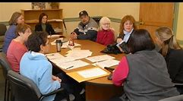
TIPS for IEP meeting
During the IEP
stay calm
listen to presenters
take notes - amount of services, accommodations, etc - for yourself
don’t be afraid to ask questions
its ok to take a break
participate actively
stay on the agenda
don’t use “I” statements
stay focused on your child needs
(YOU ARE YOUR FIRST CHILD ADVOCATE)
At the END of the IEP
make sure there is time to read notes
make sure all services, accommodation, equipment is listed
its ok to not sign the IEP at the meeting.
its ok request a visit of placement/program for your child.
After the IEP MEETING
follow up
sign IEP as soon as possible
its ok to sign with Exception to.
its ok if another meeting is need to answer concerns or question.

Slide 9
Who to ask for HELP or QUESTION
Site Level
Teacher
Case Carrier
Principal
District Level
Program Specialist
Special Education
Coordinator
Director
County Level
Selpa Coordinator
Selp Director / Personal
State Level
CA Department of Education /
Special Eucation Division
Office of Administration Hearing
**Document all Correspondence

Slide 10
Major Federal Law and Special Education

Slide 11
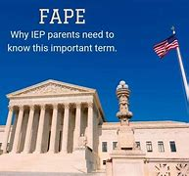
Right Under IDEA (Individual with Disabilities Education Act)
Free Appropriate Public Education (FAPE)
Special Education and Related Services that are provided at public expense at no cost to parents.
Meet the unique needs of a child’s disability.
Opportunity to make progress toward achievement of their IEP goals and objectives
Ensure access of the child to the general education curriculum.
34 C.F.R. 300.17. EC 56040.
2. Least Restrictive Environment (LRE)
To the maximum extent appropriate, children with disabilities
Are educated with children who are nondisabled.
Placement in special classes, separate schooling, or other removal of children with disabilities
from the regular educational environment occurs, only if
the nature or severity of the disability is such that education in regular classes with use of supplementary aids and services cannot be achieved satisfactorily.
34 CFR 300.114. EC 56040.1
pg. 7, Eng-Parent Guide
pg. 1, Spn-Guia para Padres

Slide 12
Rights Under IDEA (Individual with Disabilities Education Act)
3 . Related Services (RS)
Examples
Speech and Language
Audiology
Occupational Therapy
Counseling
Adaptive Physical Education (APE)
Bus Transportation
School Nursing Services
Parent Counseling and Training
Related Services means transportation and such developmental, corrective, and other supportive services
As are required to assist a child with a disability to benefit from special education

Slide 13
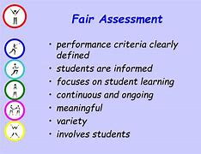
Rights Under IDEA (Individual with Disabilities Education Act)
4. Fair Assessment (also called Evaluation)
Determine whether the child is a child with a disability.
Child is assessed in all areas of suspected disability
Use a variety of assessment tools and strategies to gather relevant functional, developmental, and academic information.
Not use any single measure or assessment as the sole criteria for determining an appropriate educational program for the child
20 USC 1414. 34 CFR 300.304.

Slide 14
Protections Under IDEA (Individual with Disabilities Education Act)
DUE PROCESS - Due process is described in the legal procedural safeguards. They are designed to ensure that parents provide informed consent regarding special education programs offered. Further, due process provides a mechanism for the resolution of disagreements
Individualized Education Program (IEP) - Is also known as an IEP. This is a plan or program developed to ensure that a child with an identified disability who is attending an elementary or secondary educational institution receives specialized instruction and related services.
Pg. 7-8, Eng-Parent Guide
Pg. 6, Spn-Guia de Padres

Slide 15
Part C of IDEA (Individual with Disabilities Education Act)
Section 504 of the Rehabilitation Act
Section 504 guarantees that people with disabilities may not be discriminated against because of their disability. While IDEA protects children in the area of education,
Section 504 protects those with disabilities for life and encompasses the right to vote, accessibility, and employment, in addition to education.
Americans with Disabilities Act (ADA) of 1990
The ADA guarantees equal opportunity for individuals with disabilities in employment, public accommodations, transportation, state and local government services, and telecommunications.

Slide 16
Tool Kit Documents and Acronyms to Know
Acronyms
IDEA | Individuals with Disabilities Education Act
FAPE | Free Appropriate Public Education
IEP | Individualized Education Program
RS | Related Services
PLOP | Present Levels of Performance
BIP | Behavior Intervention Plan
IEE | Individual Education Evaluation
PWN | Prior Written Notice
ADR | Alternative Dispute Resolution
CDE | California Department of Education
LEA | Local Education Agency
SELPA | Special Education Local Plan Area
OAH | Office of Administrative Hearings
CFR | Code of Federal Regulations
CEC | California Education Code
USC | United States Code
SPED | Special Education Local Plan Area
ADA | Americans with Disabilities Act

Slide 17
HOME LIFE
It is important to maintain an organized home file of your child’s records.
Educational History
Annual reports
Evaluations
Copies of the IEP
Contact list
Work samples
Medical History
Medical records
Diagnosis
Family History

Slide 18
THANK YOU
FOR
YOUR ATTENDANCE
Sources:
Code of Federal Regulations Implementing the IDEA California Education Code – Part 30
Individuals with Disabilities Education Act United States Code
Family Education Rights Privacy Act (FERPA)

